Slide 1
Manufacturing Technology 06/02/2018 (ME461)
Instructor: Shantanu Bhattacharya

Slide 2
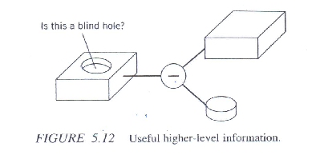
Feature Recognition In Computer Aided Process Planning
Capp systems usually serve as a link between CAD and CAM.
However, it is only a partial link, because most of the existing CAD/drafting systems do not provide part feature information, which is essential data for CAPP.
CAPP systems do not understand the three dimensional geometry of the designed parts for CAD systems in terms of their engineering meaning related to manufacturing and assembly.
This is commonly referred to as the feature recognition problem.
For example the object shown in the solid geometry tree given below represents a block primitive and a cylinder primitive combined by a Boolean operator .
The shape and dimension of the object are uniquely defined by this scheme.
However, some useful higher level information such as whether the hole is a blind hole or a through hole is not provided.
This kind of information, defined in terms of feature, is essential to process planning.
Notes:
For example , for the mentioned part, if there is a through hole, the process plan may be different from that in the blind hole case.

Slide 3
Feature recognition in computer aided process planning
From an engineering point of view, features are regarded as generic shapes of objects with which engineers associate certain attributes and knowledge useful in reasoning about or describing the products.
A generic part feature recognition system should be able to:
Extract design information of a part drawn from a CAD database.
Identify all surface of the part.
Recognize, reason about, and interpret these surfaces in terms of part features.

Slide 4
Part feature recognition approaches
A number of approaches to part feature recognition for rotational as well as prismatic parts have been developed such as syntactic pattern recognition, geometry decomposition, expert system rule logic, graph based and set rhetoric out of which Graph based approach will be explored here.
Graph based approach:
This usually consists of three basic steps:
STEP1: Generating graph based representation of the object to be recognized.
STEP2: Defining part features.
STEP3: Matching features in the graph representation.
In the first step, an object is represented by graph. This step is necessary because the data extracted from the database are usually in the form of boundary representation and are not directly usable for feature recognition.
In order to recognize a feature, the information regarding the type of face adjacency and relationships between the sets of faces should be expressed explicitly.
To facilitate the recognition process the AAG (attributed adjacency graph) method is used.

Slide 5
Definition of Attributed Adjacency Graph
An AAG can be defined as a graph G = (N,A,T), where N is the set of nodes, A is the set of arcs, and T is the set of attributes to arcs in A such that:
For every face f in F, there exists a unique node n in N.
For every edge e in E, there exists a unique arc a in A, connecting nodes n_{i} to n_{i} corresponding to face f_{i} and face f_{j} which share the common edge e.
Every arc a in A is assigned an attribute t, where:
t = 0 if the faces sharing the edge form a concave angle [inside edge]
t= 1 if the faces sharing the edge form a convex angle [ ourside edge]

Slide 6
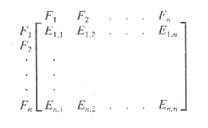
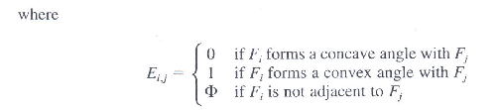
Definition of Attributed Adjacency Graph
The AAG is represented in the computer in the form of a matrix, which is defined as follows:

Slide 7
Definition of part features
To achieve feature recognition, we first need to define the feature precisely- that is , what shape we think is a feature.
Generally, we can define any shape as a feature; however, only those that have manufacturing meanings should be defined.
Six commonly used features in manufacturing are the step, slot, three side pocket, four side pocket, pocket (or blind hole), and through hole.

Slide 8
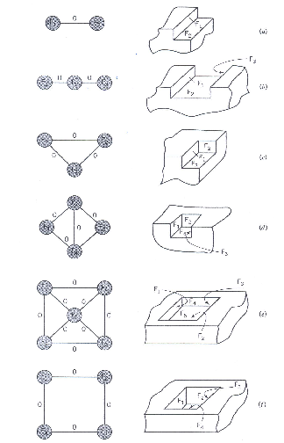
Defining features

Slide 9
Matching the feature
After steps 1 and 2, the problem of recognizing machining features in part changes to the problem of recognizing AAG subgraphs that represent the features in the complete AAG graph representing the part.
The problem of searching of subgraphs in a larger graphs is a subgraph isomorphism problem and is computationally exhaustive and as such there are no polynomial algorithms to do this.
An algorithm that can be an alternative to isomorphism can be based on the following observation: A face that is adjacent to all its neighboring faces with convex angle (270 deg.) does not form part of a feature.
This observation is used as a basis of separating the original graph into subgraphs that could correspond to features.
The separation is done by deleting some nodes of the graph. The delete node rule is as follows:
If (all incident arcs of a node have attribute “1”)
Then (delete this node (and all the incident arcs at the node) from AAG)
Because an AAG is represented in the form of a matrix in the program, the delete node rule actually deletes rows and columns that represent the nodes in the matrix.

Slide 10
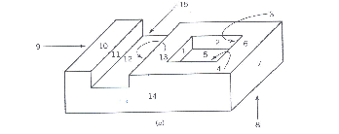
Problem
It is easy for the human to see that the part shown below has a slot and a pocket feature. In this example, however, we simulate the computer to apply the feature recognition algorithm discussed earlier. We therefore, want to solve the following:
(a)Develop the AAG of the object.
(b) Give the matrix representation of the AAG.
(c)Recognize the features in this object.

Slide 11
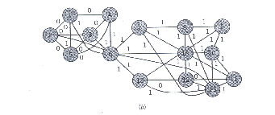
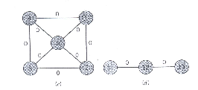
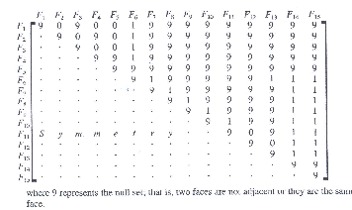

Solution
(a)The AAG is first developed as shown below
For the purpose of inputting the AAG graph into the computer, we have to convert the graph into the matrix form. The matrix representation of AAG is given as follows:

Slide 12
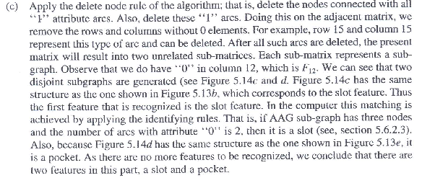
Solution

Slide 13
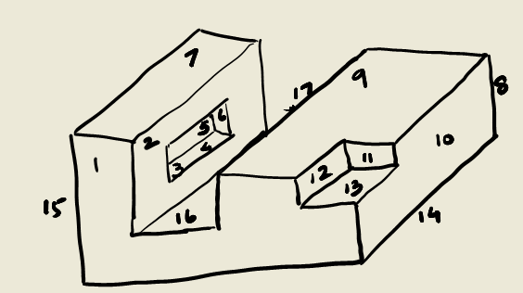
Example to be solved
For the object shown in the figure below, use the graph based feature recognition approach to achieve the following:
(a)Develop the AAG of the object.
(b) Give the matrix representation of the AAG.
(c) Recognize the features in this object.

